Slide 1
Content
Introduction
Problem Statement
Objectives
Methodology
Implementation
Application of the Project

Slide 2
1. Introduction
In today's digital landscape, cybersecurity threats are ever-evolving and increasingly sophisticated, posing significant challenges to organizations worldwide.
Penetration testing, a critical aspect of cybersecurity, involves identifying and exploiting vulnerabilities in systems and networks to assess their security posture.
Hunt3r is an innovative automated penetration testing framework designed to streamline and enhance the efficiency of security testing processes.
Leveraging advanced techniques and modular architecture, Hunt3r aims to empower organizations to proactively identify and address vulnerabilities within their networks, applications, and systems.

Slide 3
1. Introduction (contd.)
By automating all major phases of penetration testing, Hunt3r streamlines the testing process, enhances efficiency, and improves the accuracy of vulnerability identification and exploitation.
The presentation will delve into the problem statement, objectives, methodology, implementation, and application of the Hunt3r framework, showcasing its significance in enhancing cybersecurity practices.

Slide 4
2. Problem Statement
"Manual pen testing is slow, outdated, and leaves you vulnerable. Enter Hunt3r, the automated framework that:
Automates tasks: Save time, identify more.
Uncovers hidden flaws: Advanced techniques find zero-day exploits.
Monitors continuously: Stay ahead of emerging threats.
Scales effortlessly: Handles any network size, complexity.
Hunt3r: Streamline security, empower action, outsmart cyber threats."

Slide 5
3. Objectives
Automate key pen testing tasks: Reduce manual effort, freeing up security experts for strategic work.
Enhance vulnerability detection: Utilize advanced techniques to uncover diverse threats, including zero-day exploits.
Enable continuous security monitoring: Schedule regular scans to stay ahead of emerging vulnerabilities and track remediation progress.
Improve security assessment efficiency: Reduce time and resource demands for comprehensive security testing.

Slide 6
3. Objectives
Increase vulnerability detection accuracy: Minimize false positives and prioritize critical vulnerabilities for faster remediation.
Adapt to various network sizes and complexities: Scale performance and capabilities based on organizational needs.
Empower data-driven security decisions: Provide detailed reports and actionable insights to guide remediation efforts.
Foster proactive security posture: Enable organizations to identify and address vulnerabilities before attackers exploit them.

Slide 7
4. Methodology
Creating Hunt3r include several steps:
1. Pre-Engagement and Planning:
Gather information: Define target scope, network architecture, and risk tolerance.
Customize scan parameters: Adjust scan depth, intensity, and excluded areas based on specific needs.
Schedule scans: Set up regular scans for continuous monitoring or one-time assessments.
2. Reconnaissance and Information Gathering:
Passive reconnaissance: Collect publicly available information about the target network and potential vulnerabilities.
Active discovery: Identify hosts, services, and open ports with tools like nmap and Netdiscover.
Fingerprint systems and services: Gather version and operating system information for vulnerability targeting.

Slide 8
4. Methodology (contd.)
3. Vulnerability Scanning and Exploitation:
Identify vulnerabilities: Utilize automated scanners like OpenVAS, Nexpose, or Qualys to identify known vulnerabilities.
Exploit vulnerabilities: Employ tools like Metasploit and custom scripts to attempt exploitation based on scan results.
Assess impact and severity: Evaluate the potential impact of identified vulnerabilities and prioritize critical issues.
4. Post-Exploitation and Reporting:
Gather post-exploitation information: Collect evidence of successful exploitation and potential access gained.
Generate detailed reports: Provide comprehensive reports with vulnerability descriptions, severity levels, remediation steps, and CVSS scores.
Visualize results: Offer report for easy understanding of vulnerabilities and scan findings.

Slide 9
5. Implementation
- Overview of the implementation process:
Initialization
Set up testing environment
Install and configure required tool
Reconnaissance
Automated gathering of information about the target system and network
by using OSINT tools such as Whois etc
Scanning
Automated scanning for vulnerabilities using tools like Nmap, Nessus, etc.

Slide 10
Exploitation
Automated exploitation of identified vulnerabilities using tools like Metasploit, ExploitDB, Searchsploit etc.
Post-Exploitation
Automated analysis of compromised systems for further exploration and lateral movement.
Reporting
Generate comprehensive reports with findings and recommendations for exploits to penetrate into the system/network

Slide 11
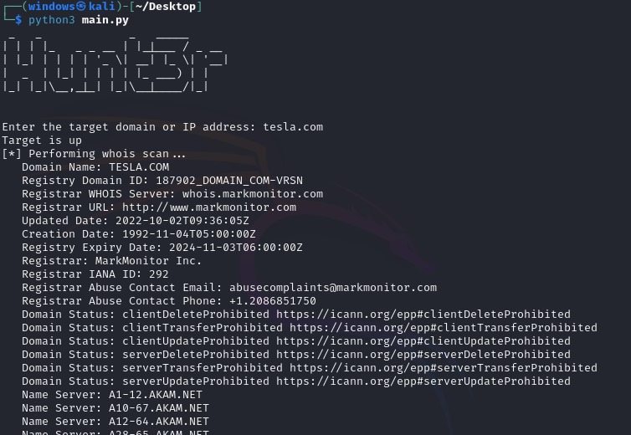
Reconnaissance using Whois

Slide 12
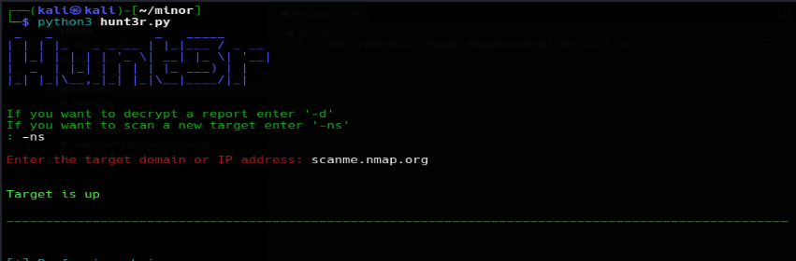
Check the target state

Slide 13
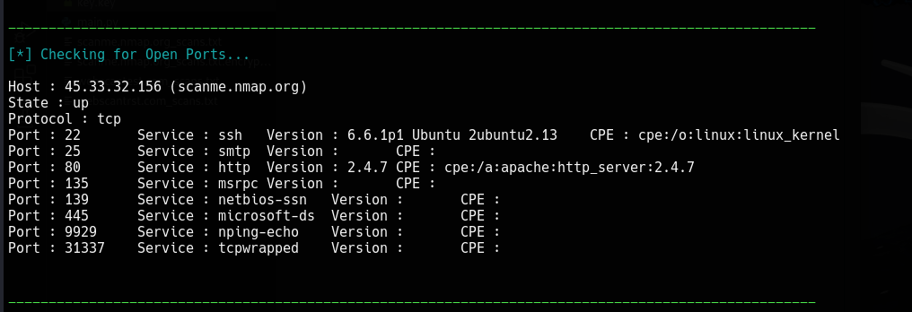
Scanning For Open ports of the target with their port number , service , version and CPE

Slide 14
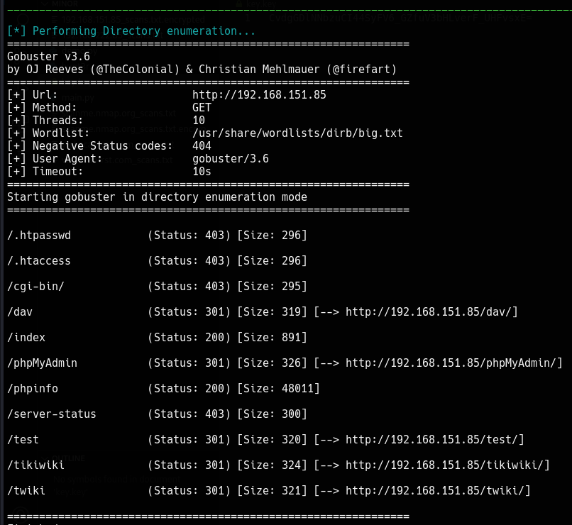
Directory Enumeration using gobuster

Slide 15
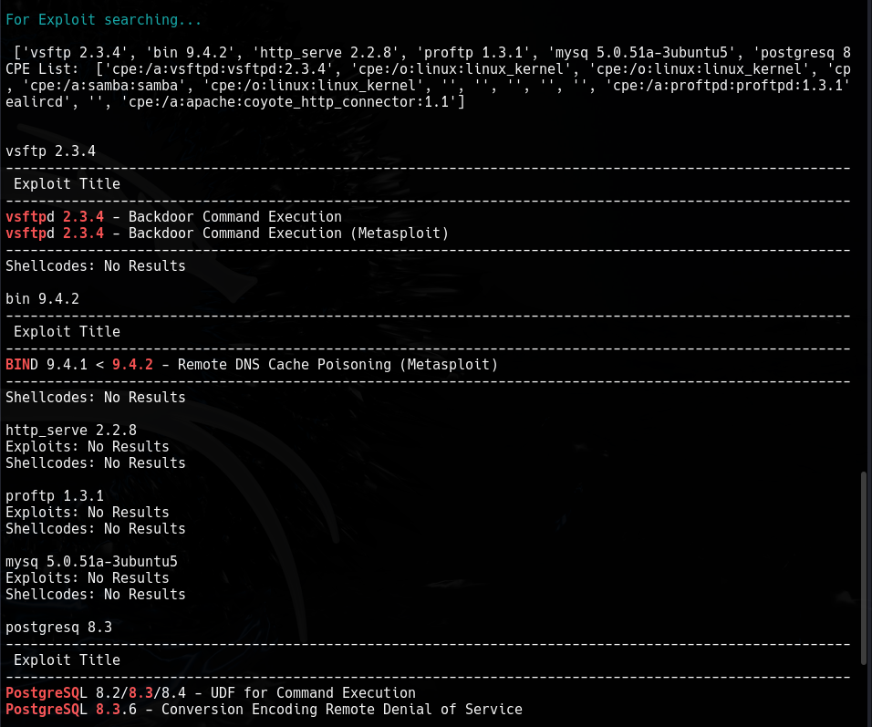
Finding Exploits on the target

Slide 16
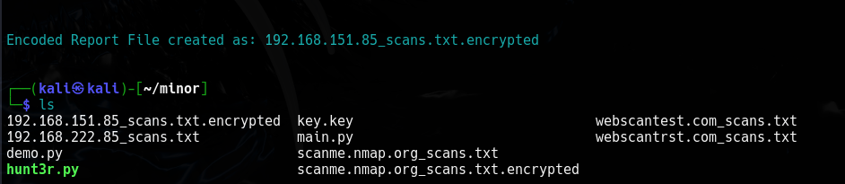
Generated Report from the target
AES encryption is performed on the text file
Using Fernet

Slide 17
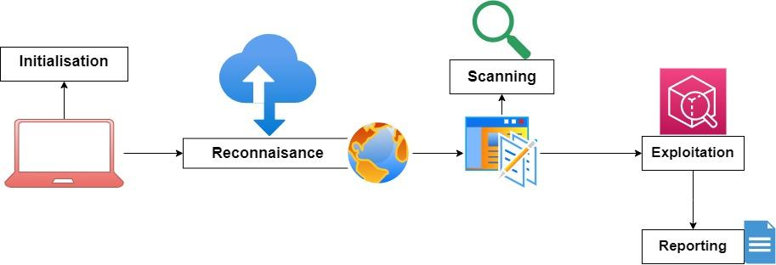
5. Implementation(Cont.)

Slide 18
6. Application of the Project
Penetration Testers: Automate repetitive tasks, freeing up time for strategic analysis and deeper testing.
Security Auditors: Conduct comprehensive assessments for compliance purposes or risk management.
Product Security Teams: Proactively identify and address security risks before impacting customers.
Improve overall security posture: Gain deeper insights into network vulnerabilities and prioritize remediation efforts.
Reduce cyber-attack risk: Proactively identify and address vulnerabilities before attackers exploit them.
Save time and resources: Automate manual tasks and improve security testing efficiency.

Slide 19

Thank You

